Slide 1

Loan Default Prediction
GROUP 1

Slide 2

Members
Maurice Kimanzi - Group leader
Elena Mwangi
David Muna
Annette Martha
Valentine karimi
Vicky Mumo

Slide 3

What if we could predict loan payment?

Slide 4
We embark on a research to find out the odds of customers paying loans based on previous loans they have taken.
We use data collected from SuperLender digital lenders for our analysis and prediction.

Slide 5
Our Goal?
Predict Loan default possibilities.

Slide 6
The Process.
Problem Definition
Data Sourcing and Understanding
Data Preparation and Cleaning.
Analysis.

Slide 7
Analysis.
Descriptive Statistics.
Feature Engineering.
Univariate and Bivariate Analysis.
Hypothesis Testing.

Slide 8
Results
After performing our various analytical approaches, we obtained the following;

Slide 9
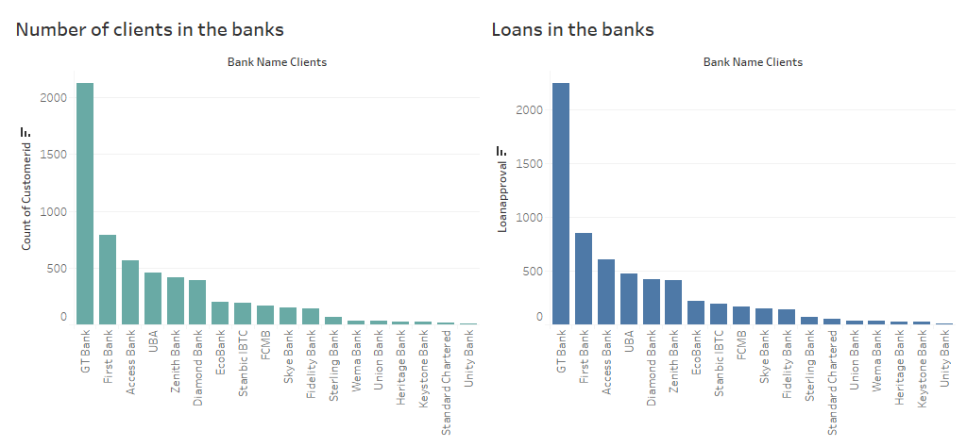
GT Bank has the highest number of customers as well as the highest loans.
Lenders should focus more on GT Bank because of the high number of customers.
The trend with customers is the same as that of loans in the banks.

Slide 10
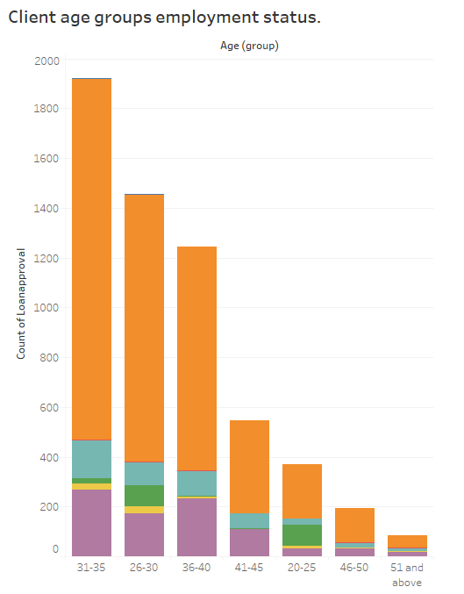
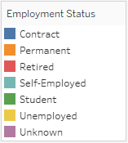
Clients within the age of 31-35 years took the highest number of loans.
The permanently employed clients took the most loans across the age groups.

Slide 11
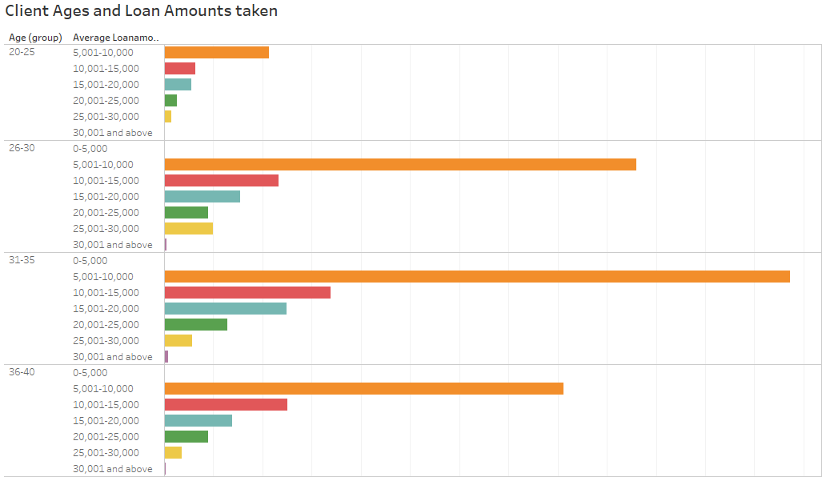
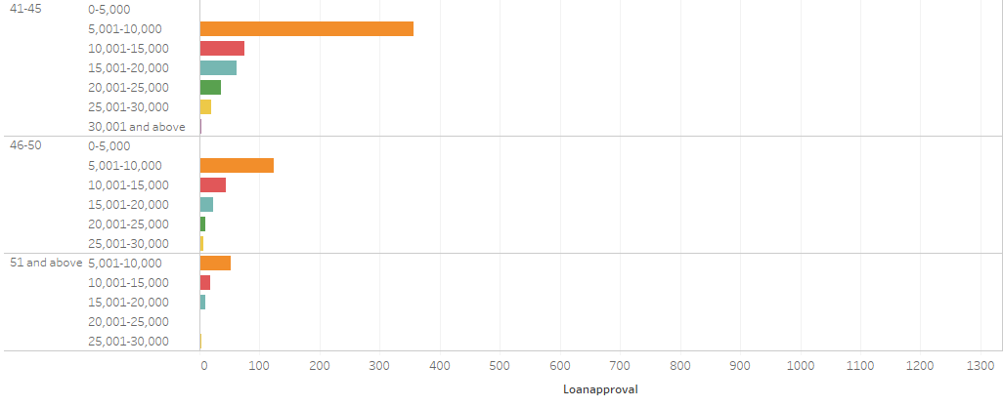
Most clients take loans in the range of 5,000-10,000

Slide 12
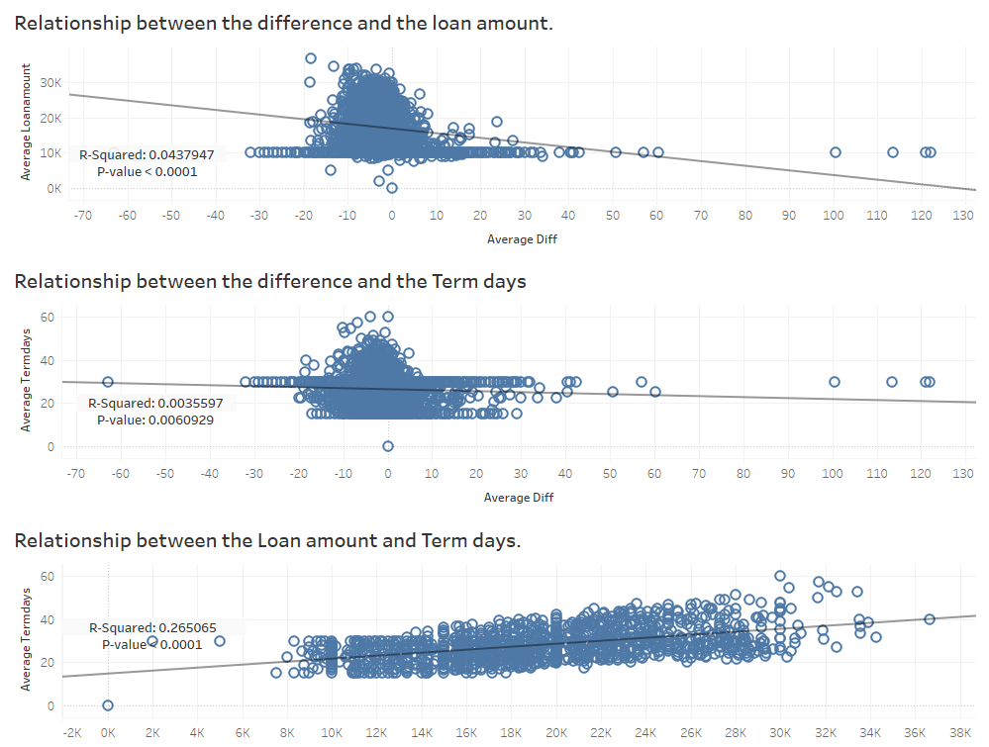
There is a relationship between the loan amount and the average difference(Lateness or timely payment of loan), although the low value of r_squared shows there are not fully dependable on each other.
There is also a relationship between the average difference and the term days for the loan although they aren’t fully dependable on each other.

Slide 13
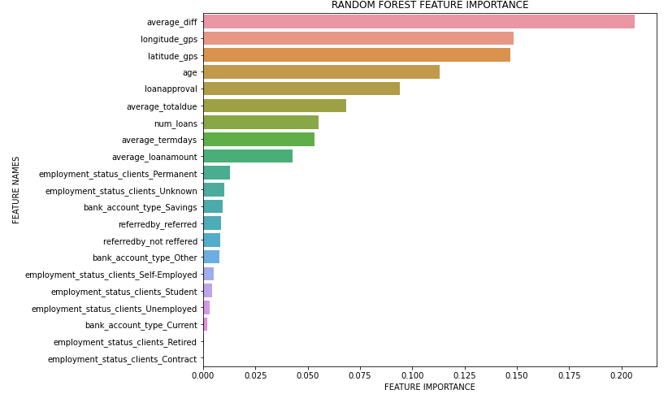

Slide 14
Conclusion
The following all contribute to the profiling of a loan;
Time taken to pay first payment,
Age of client,
Location of the client,
Number of loans borrowed,
Employment status,
Loan amounts borrowed,
Time taken for earlier loans’ approval.

Slide 15

Thank You!

